Slide 1
Week 5c
COMPUTATIONAL MATHEMATICS
Taylor Series

Slide 2
Reference
Kisualaas, Jann. (2013). Numerical Methods in Engineering with Python 3. Cambridge University Press.
Johansson, Robert. (2015). Chapter 5. Equation Solving. Numerical Python: A Practical Techniques Approach for Industry, Apress.
Chapra, S. C., and Raymond P. Canale. (2010). Numerical methods for engineers, Sixth edition, McGraw Hill.
Kaw, A. (n.d.). Numerical Methods. Retrieved March 20, 2020, from https://nm.mathforcollege.com/

Slide 3
What is a Taylor series?
Some examples of Taylor series which you must have seen

Slide 4
General Taylor Series
The general form of the Taylor series is given by
provided that all derivatives of f(x) are continuous and exist in the interval [x,x+h]
What does this mean in plain English?
As Archimedes would have said, “Give me the value of the function at a single point, and the value of all (first, second, and so on) its derivatives at that single point, and I can give you the value of the function at any other point” (fine print excluded)

Slide 5
Example—Taylor Series
Find the value of
given that
and all other higher order derivatives
of
at
are zero.
Solution:

Slide 6
Example (cont.)
Solution: (cont.)
Since the higher order derivatives are zero,
Note that to find
exactly, we only need the value
of the function and all its derivatives at some other point, in this case

Slide 7
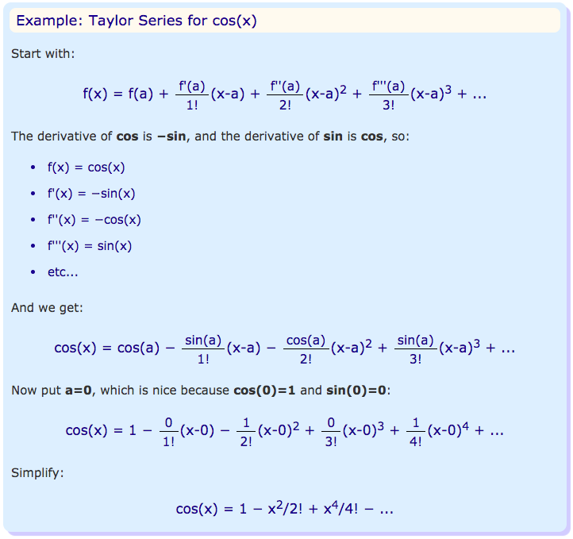

Slide 8
Derivation for Maclaurin Series for e^{x}
Derive the Maclaurin series
The Maclaurin series is simply the Taylor series about the point x=0

Slide 9
Derivation (cont.)
Since
and
the Maclaurin series is then
So,

Slide 10
Error in Taylor Series
The Taylor polynomial of order n of a function f(x) with (n+1) continuous derivatives in the domain [x,x+h] is given by
where the remainder is given by
where
that is, c is some point in the domain [x,x+h]

Slide 11
Example—error in Taylor series
The Taylor series for
at point
is given by
It can be seen that as the number of terms used
increases, the error bound decreases and hence a
better estimate of the function can be found.
How many terms would it require to get an approximation of e¹ within a magnitude of true error of less than 10^{-6.}

Slide 12
Example—(cont.)
Solution:
Using
terms of Taylor series gives error
bound of
Since

Slide 13
Example—(cont.)
Solution: (cont.)
So if we want to find out how many terms it would
require to get an approximation of
within a
magnitude of true error of less than
,
So 9 terms or more are needed to get a true error
less than

